Slide 1
DAY 2
AP Computer Science Principals
Course Importance and Overview

Slide 2
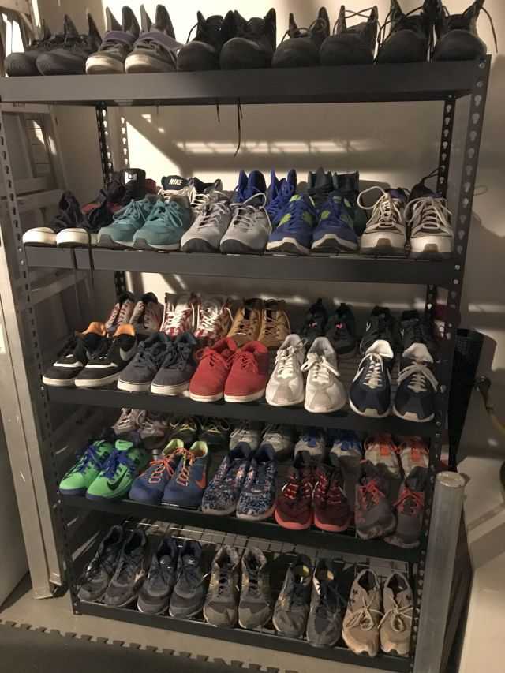
Class Rules and Regulations I am Right and You are Wrong…

Slide 3
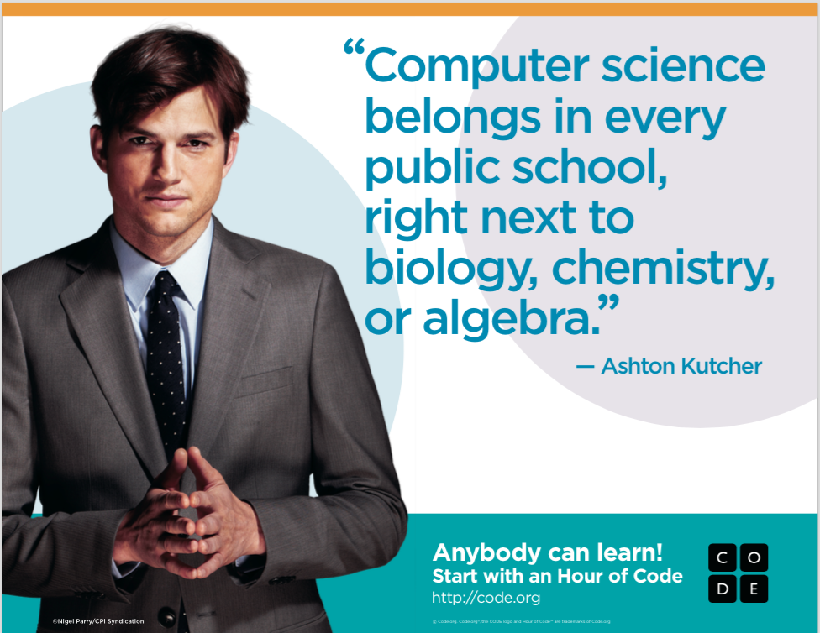
Video- Computer Science is Changing Everything

Slide 4
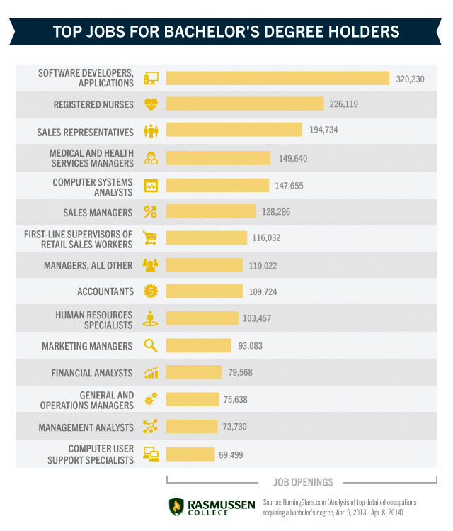
Top 10 Most in Demand Bachelor’s Degree Employees

Slide 5
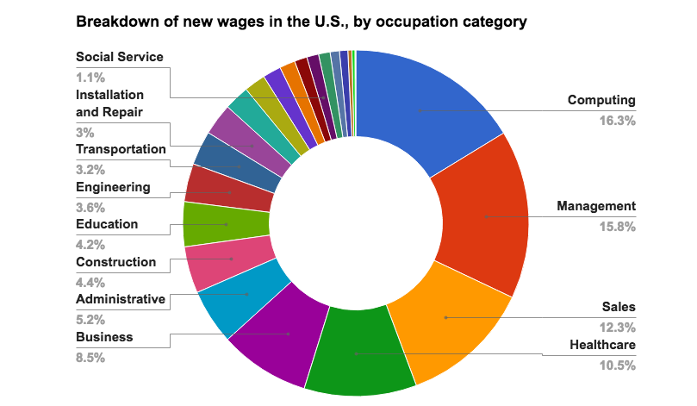

Slide 6
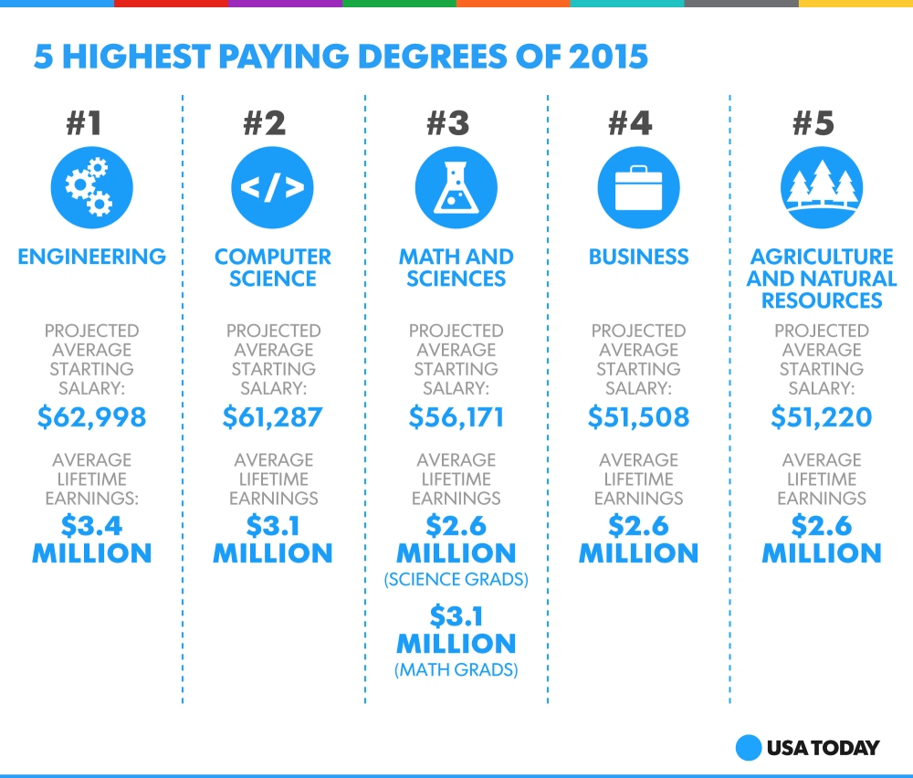

Slide 7
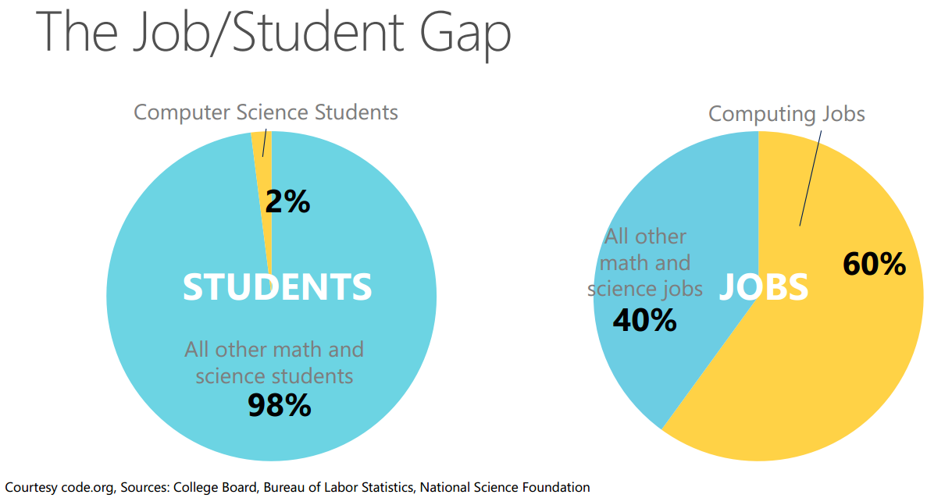

Slide 8
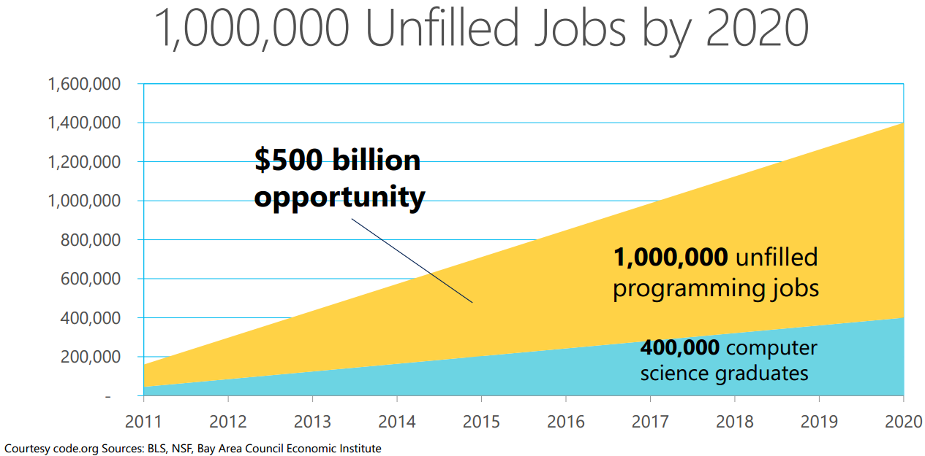

Slide 9
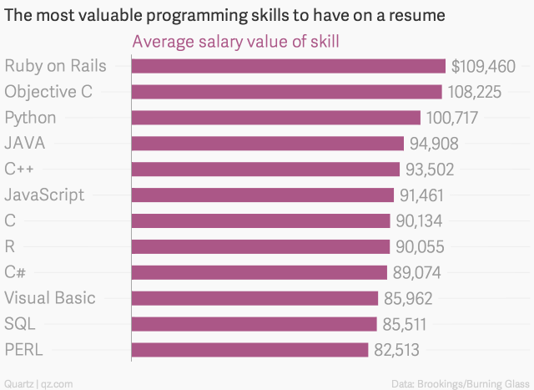

Slide 10
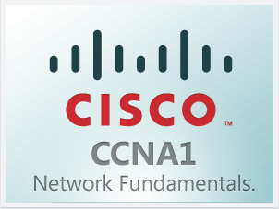
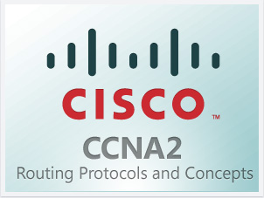
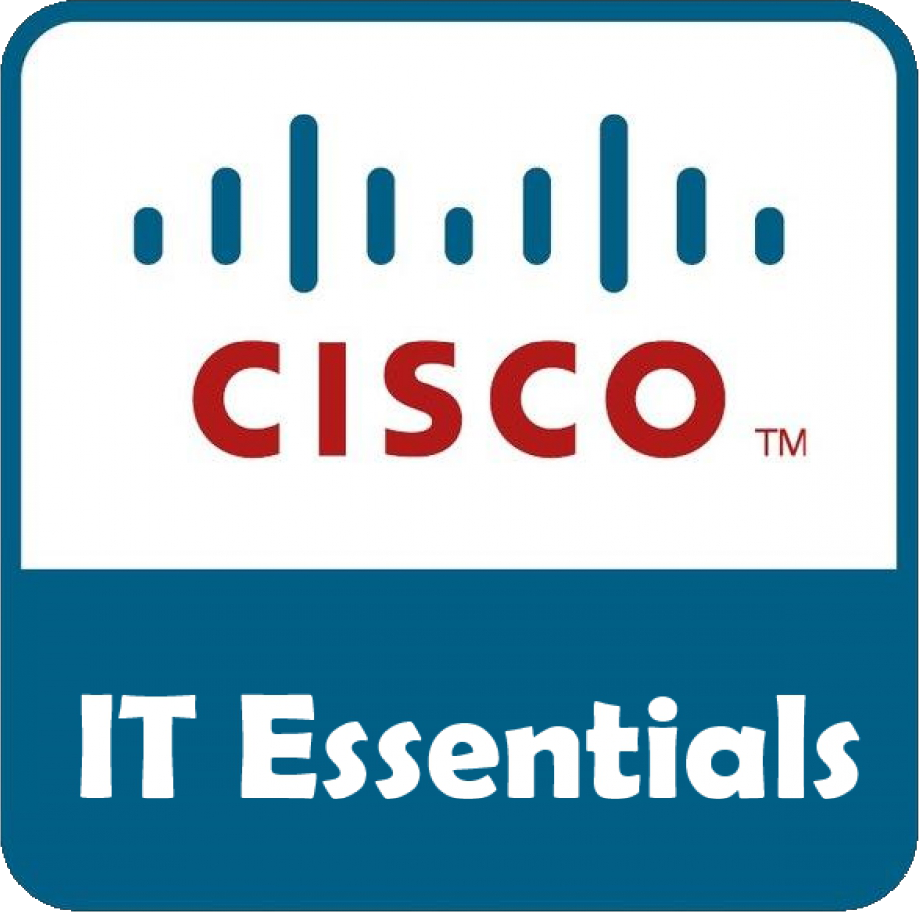
Information and Communication Technology Pathway
IT Focus
APP Dev
CS P
Software Engineering Focus
CS A
AP Computer Science Principles
Exploring IT Careers &
Introduction to Game Design
AP Computer Science A
(JAVA Programming)
Exploring Computer Science
Mobile App Development
7/8th Grade
9th Grade
10th Grade
11th Grade
12th Grade

Slide 11
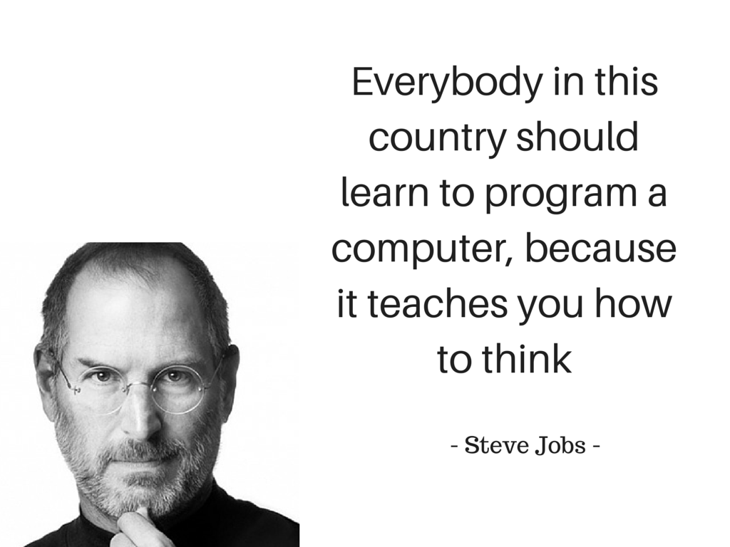
Course Overview

Slide 12
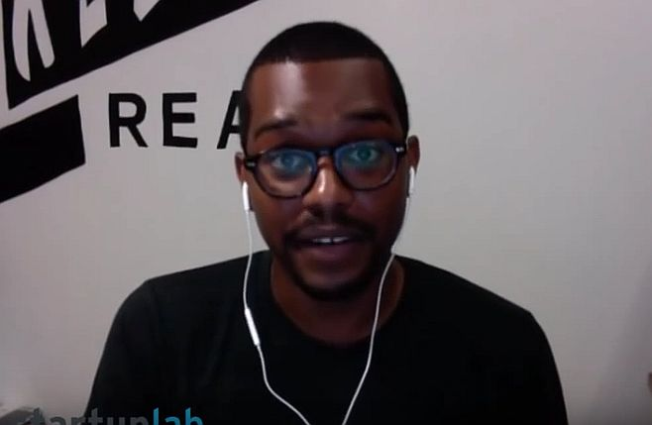
Is Learning Code Hard?

Slide 13
Course Overview
How the framework...works
+
=
7 Big Ideas
Creativity
Abstraction
Data
Algorithms
Programming
The Internet
Global Impacts
6 Computational Thinking Practices
Connecting Computing
Creating Computational Artifacts
Abstracting
Analyzing Problems and Artifacts
Communicating
Collaborating
Learning Objectives
1.2.4 Collaborate in the creation of computational artifacts. [P6]
2.2.2 Use multiple levels of abstraction to write programs. [P3]
Credit- ostrove.org

Slide 14
Assessment Breakdown + Overview
AP CSP has two assessment parts:
Two “Through-course” performance tasks | 40% of total AP score
74 Fixed-response questions | 60% of total AP score
Credit- ostrove.org

Slide 15
Performance Tasks
Two tasks:
“Create” Performance Task— programming focused (12 hours in class)
“Explore” Performance Task— research an innovation (8 hours in class)
Credit- ostrove.org

Slide 16
Performance Tasks: Create
Create
24% of total score, Due April, 2018.
Develop a program (collaboratively or on your own)
Reason about your program
Write about your program
Credit- ostrove.org

Slide 17
Performance Tasks: Create
Written responses’ overall word count comes in at a MAX of 750 words
Video of your code may include a voice-over narration, in addition to written response
Entire code needs to be submitted ( PDF copy) but it will not be run. Portions that are reviewed will be highlighted by students
Strong encouragement to collaborate - students may work on same code “base” but must produce something on their own individually and highlight it.
E.g. a game where one person works on the logic/algorithm for one character, and other student works on a different character
Written responses are individual.
...and must state “I” did one thing v. “we” did...or you might not get credit
ostrove.org

Slide 18
Performance Tasks: Explore
Explore
16% of total score, Due April, 2018.
Pick a computing innovation
Research your innovation
Write about how your innovation works, and how it impacts society
Credit- ostrove.org

Slide 19
Performance Tasks: Explore
You need to cite sources and 2 of the 3 need to be within the current school year (roughly: June-to-June)
If your computational artifact is a video: it needs to be ~60 seconds (the reviewer may stop watching at any point after 60 second mark)
Teacher can only give “Minimal Support”
Students must come up with their own topic
Teacher can help with process but not content
List of ideas for topics will be generated over the course
Three sample tasks:
http://apcentral.collegeboard.com/apc/public/exam/computer_science_principles/232377.html
http://apcentral.collegeboard.com/apc/public/exam/computer_science_principles/232378.html
http://apcentral.collegeboard.com/apc/public/exam/computer_science_principles/232379.html
Credit- ostrove.org

Slide 20
Fixed-Response Questions
Fixed Response (multiple choice)
60% of total score. 74 total questions, 2 hours. 5/11/2018
A pseudocode language for answering programming questions (emulated in code.org’s App Lab)
Some reference to “logo” code
Anything that’s not captured in the performance task will need to be measured here
Credit- ostrove.org

Slide 21
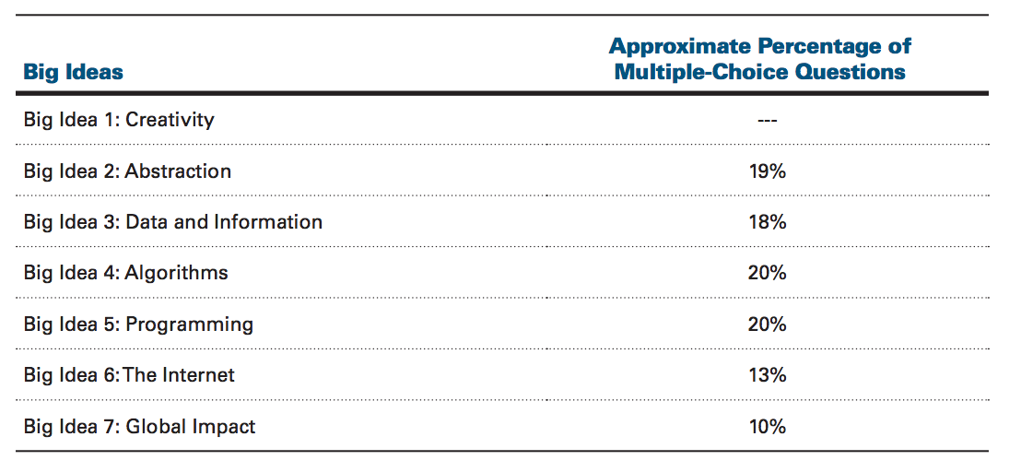
Fixed-Response Questions
Credit- ostrove.org

Slide 22
Code.org Syllabus
Mr. Burrill Syllabus
Grading Discussion
Journals Discussion

Slide 23
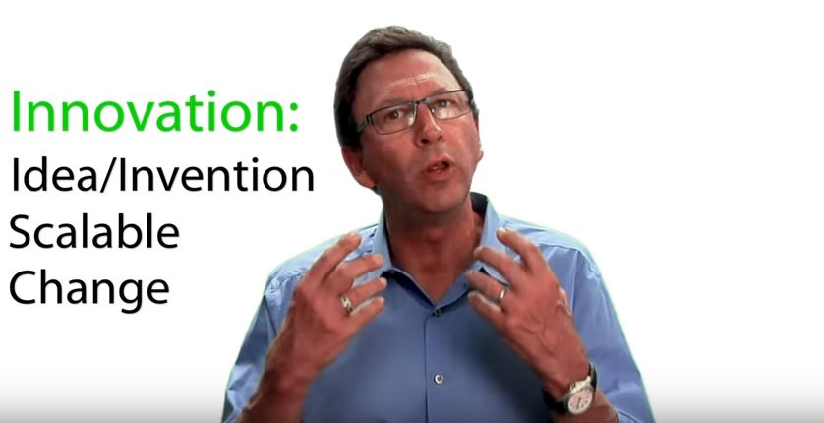
What is an Innovation?

Slide 24
Activity
Technological innovation is about recognizing a problem that needs to be solved, or recognizing something needs improving and then building a tool to solve it.
As a class we’re going to see how innovative we can be, and we’ll share our ideas through something called “rapid prototyping.” (Prototype is a fancy word that means a preliminary sketch of an idea or model for something new. It’s the original drawing from which something real might be built or created.)

Slide 25
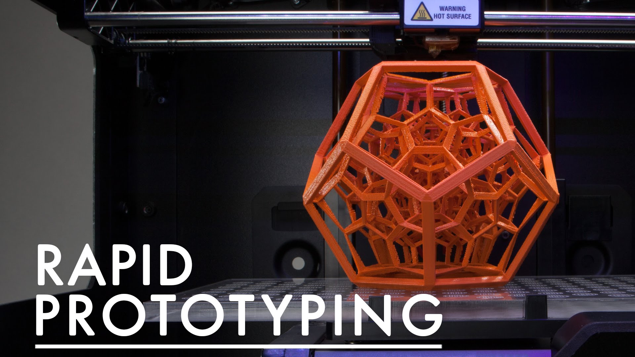
Brainstorm Technological Innovation-
With 2-3 Others
Share your idea with others in your group
Explain why you are an expert
Identify some way that technology is used with, or affects your knowledge
Discuss as a group ideas that technology could help each area of expertise
Dream big, what would be awesome in your area of expertise?
Share with the class from where you are one or two great ideas

Slide 26
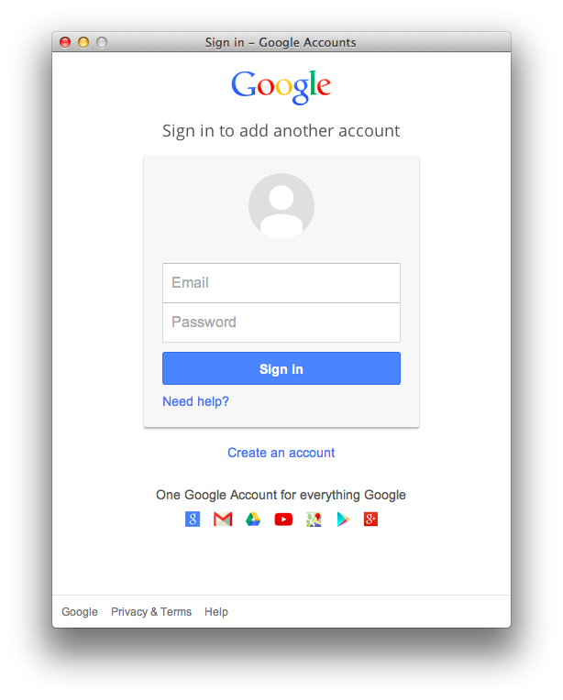
Everyday Login to Computer When You Get Here Then Log-In to Google

Slide 27
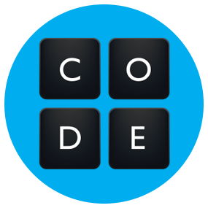
--Last Slide Today—
Code.org - Lesson 1: Personal Innovations
2019-2020 code.org Log-In Codes
Period 2- HKBFLH
Period 3- JGTCHF
Period 4- JRCZPJ
Go For it!
Complete Stage 1- Help each other out…

Slide 28
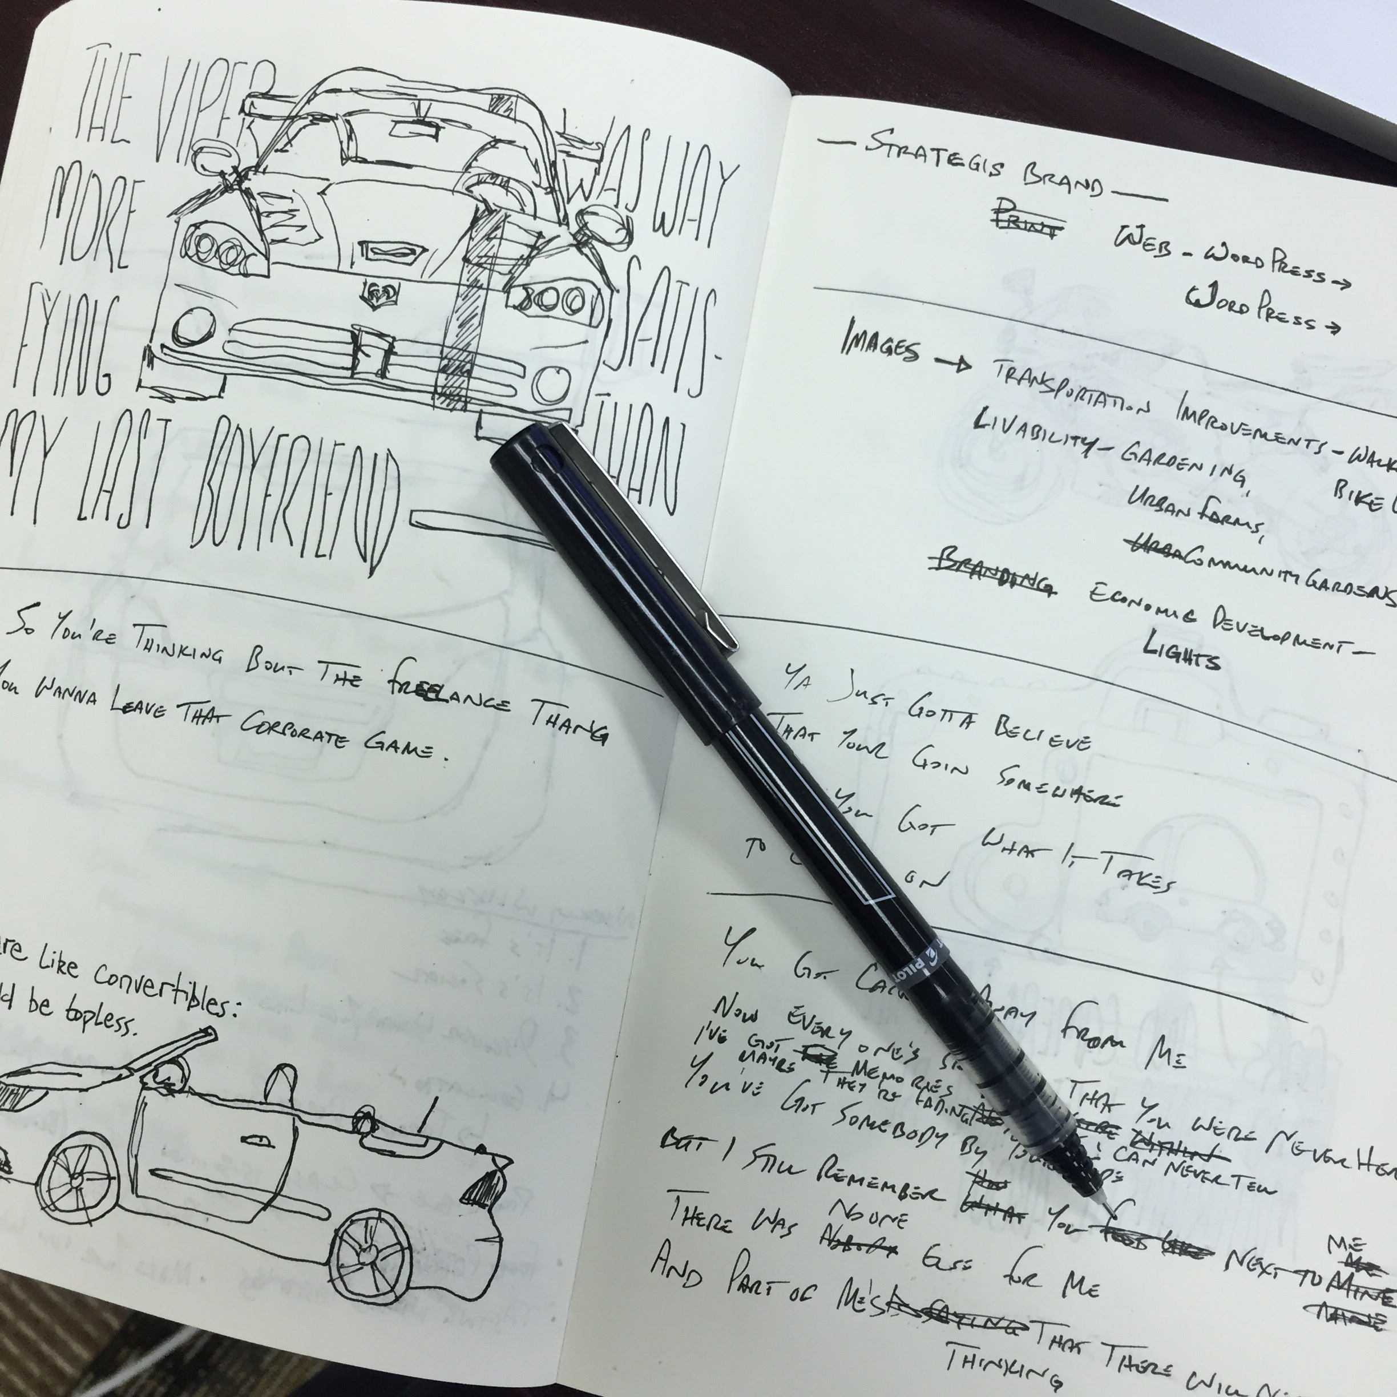
What Should Make it into Your Journal?
1- This is your homework… Place in journal what you learned from the last class
2- Add 1 Paragraph Review of Article Linked From www.wrwebheads.com
Baltimore Paying Kids to Code
3- Describe one Job You Might Be Interested in) Linked From www.wrwebheads.com
Top 10 Jobs for Computer Science Majors

